Slide 1

Mojo Menus

Slide 2
Homepage
Bence Toth
Nearest Menu
Muhunthan Ravichandran
Category Search
Kozimjon Khikmatillaev
Share Menu
Brenda Puvirajasinghe
QR Code Scanner
Minhajul Hussain
Navigate to Menu
Ashwin Khatwa

Slide 3
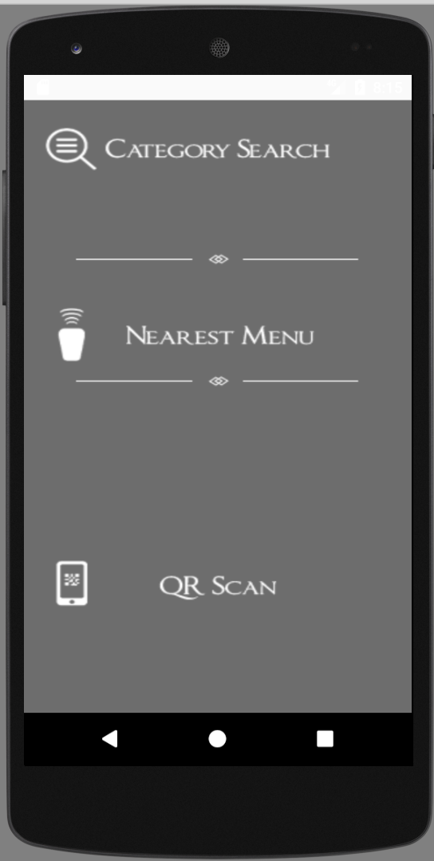
Homepage

Slide 4
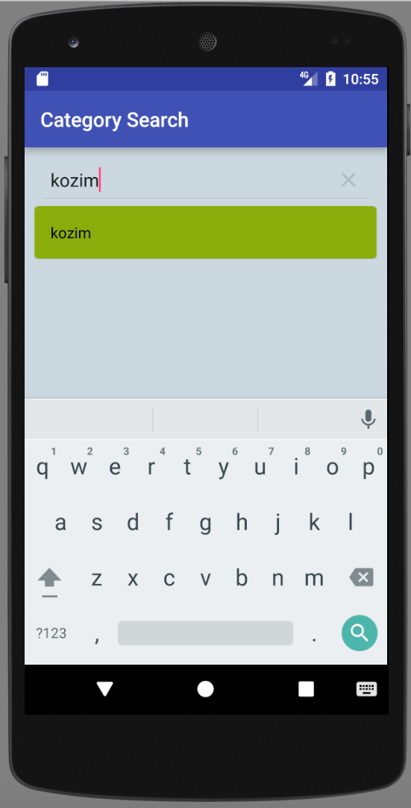
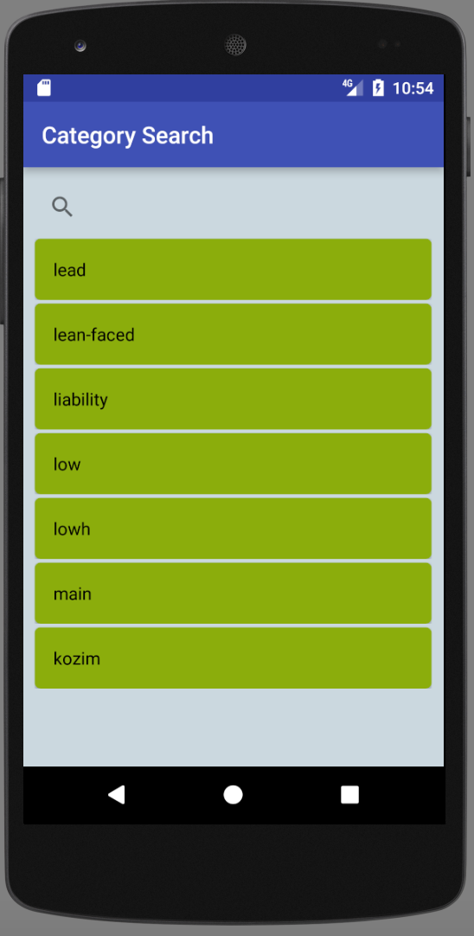
Category Search

Slide 5
QR Code Scanner

Slide 6
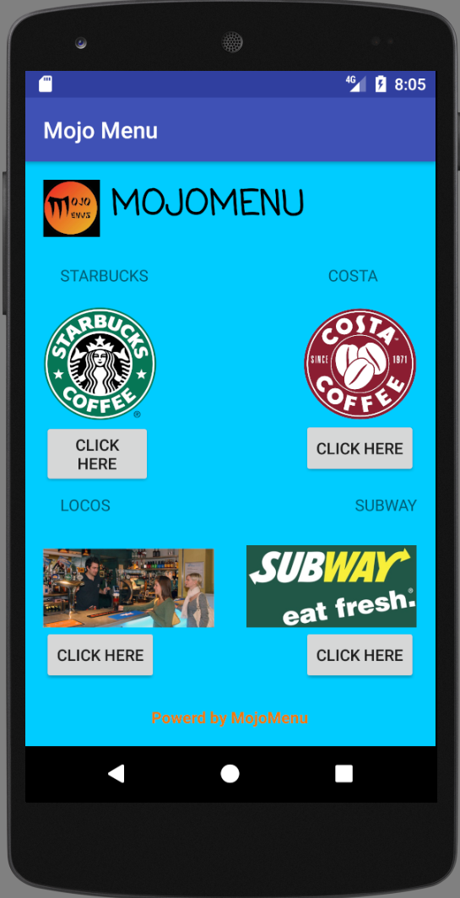
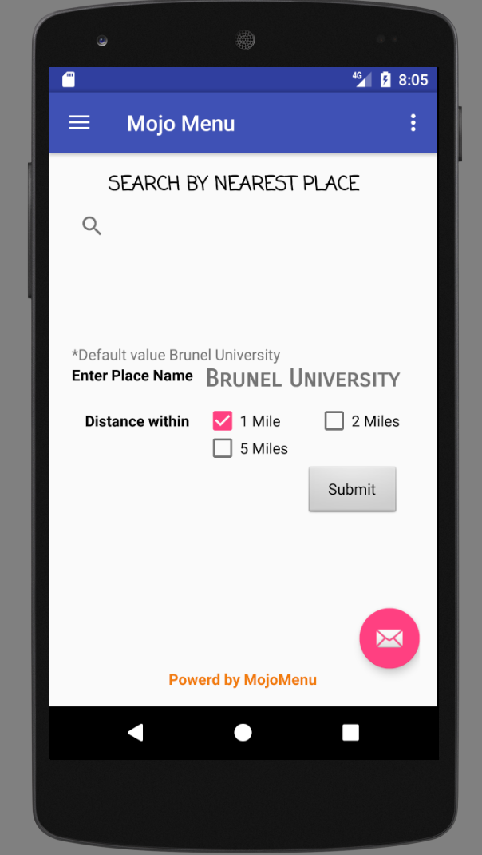
Nearest Menu

Slide 7
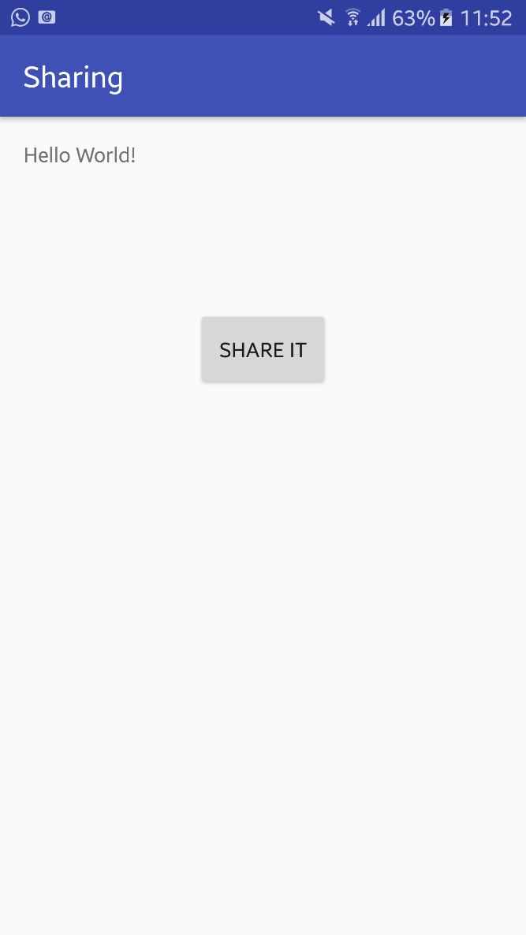
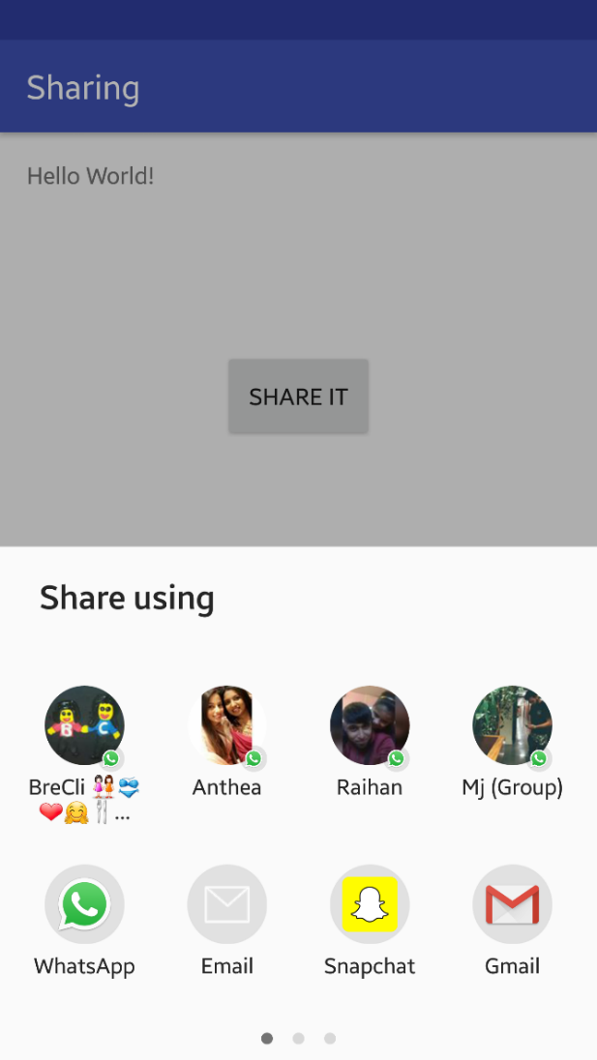
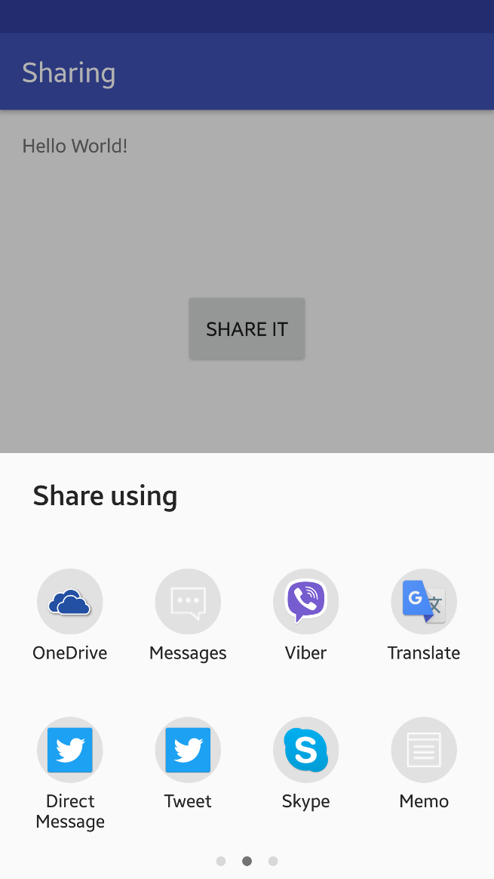
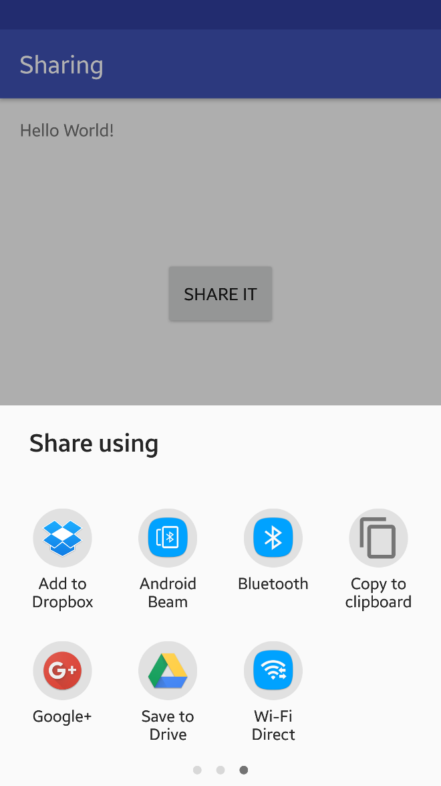

Share Menu

Slide 8
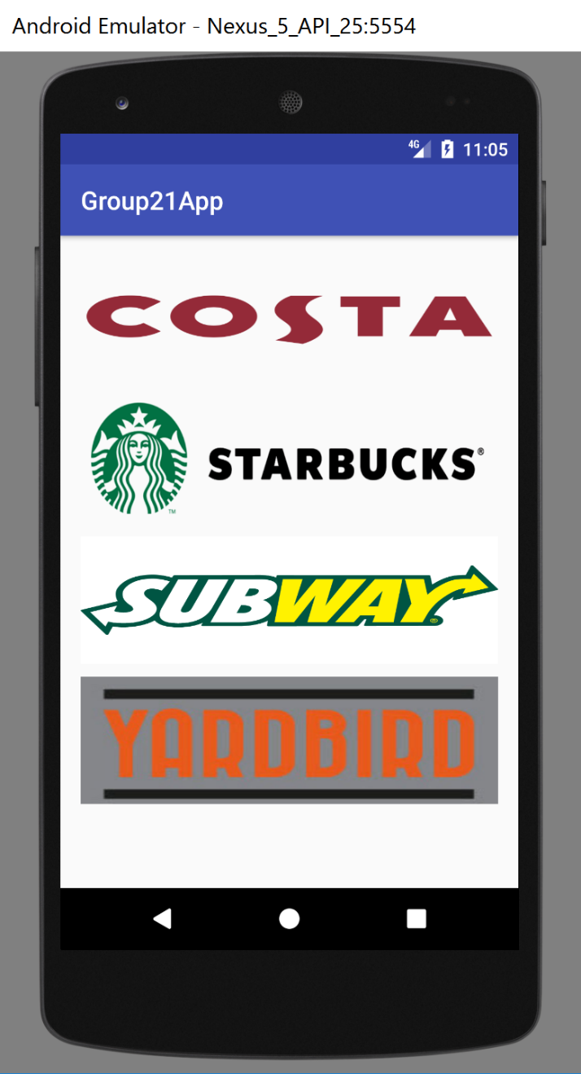
Navigate to Menu

